Slide 1
Boulder Airport Community Conversation
Open House #2
July 18, 2023
Notes:
AMF - welcome

Slide 2
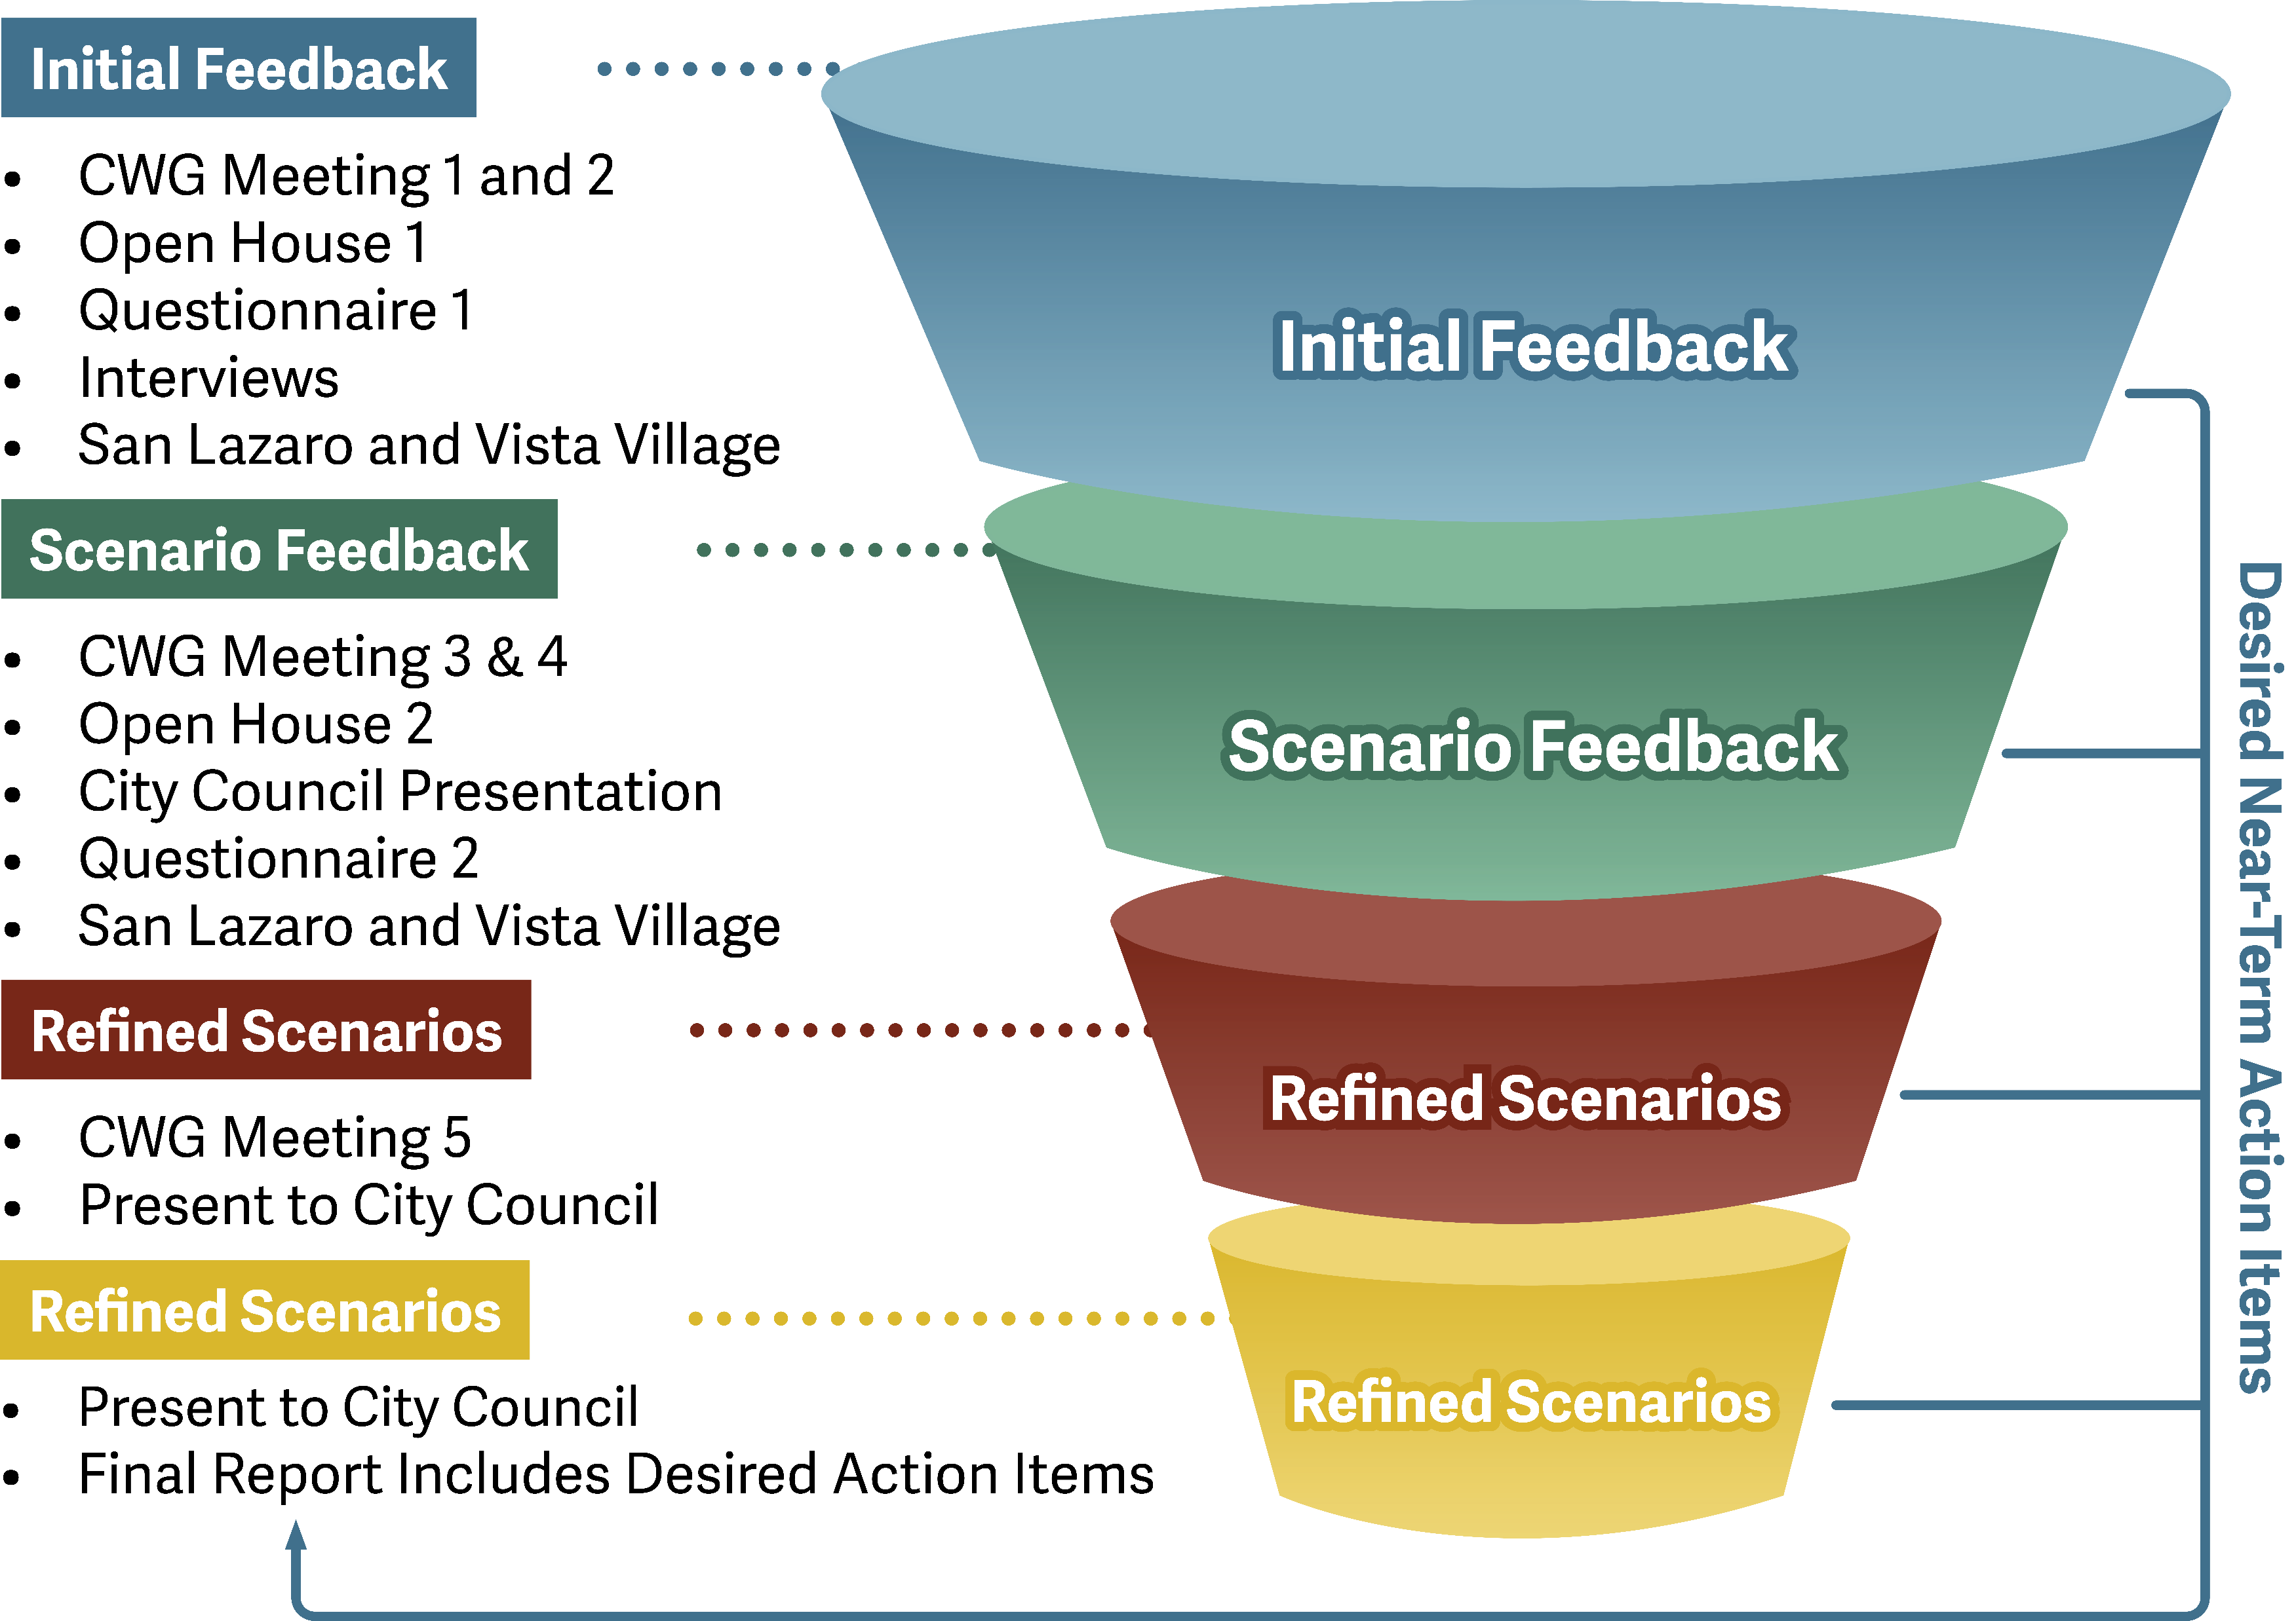
Input and Feedback
Notes:
AMF

Slide 3
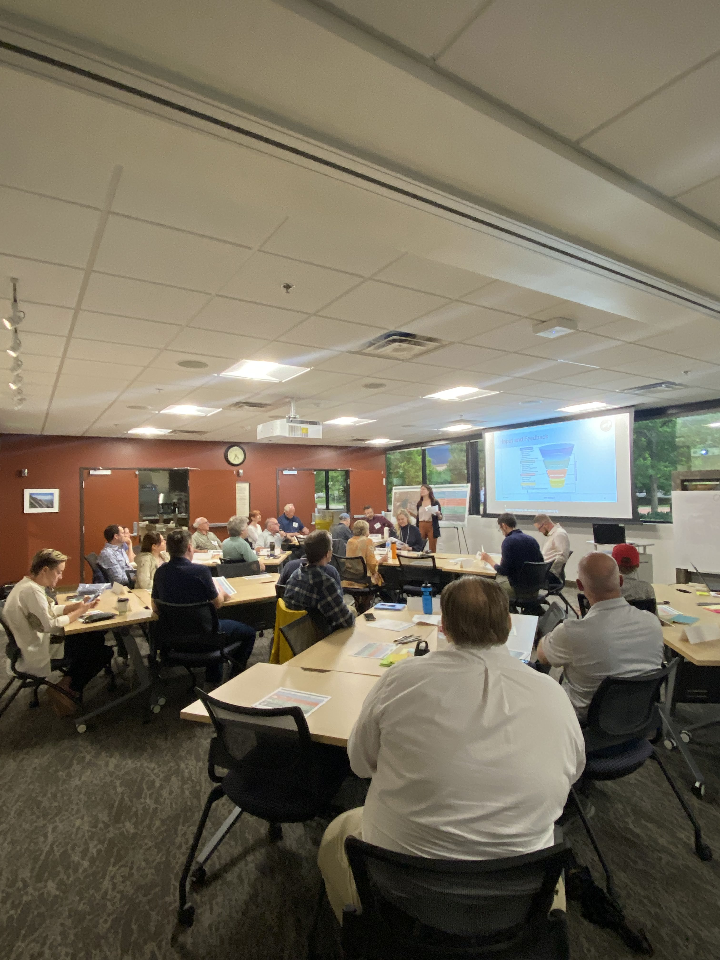
Community Working Group
Three workshop meetings, five in total
30 members diverse perspectives
Constructive dialogue
Additional meetings to connect and learn from each other
Notes:
AMF

Slide 4
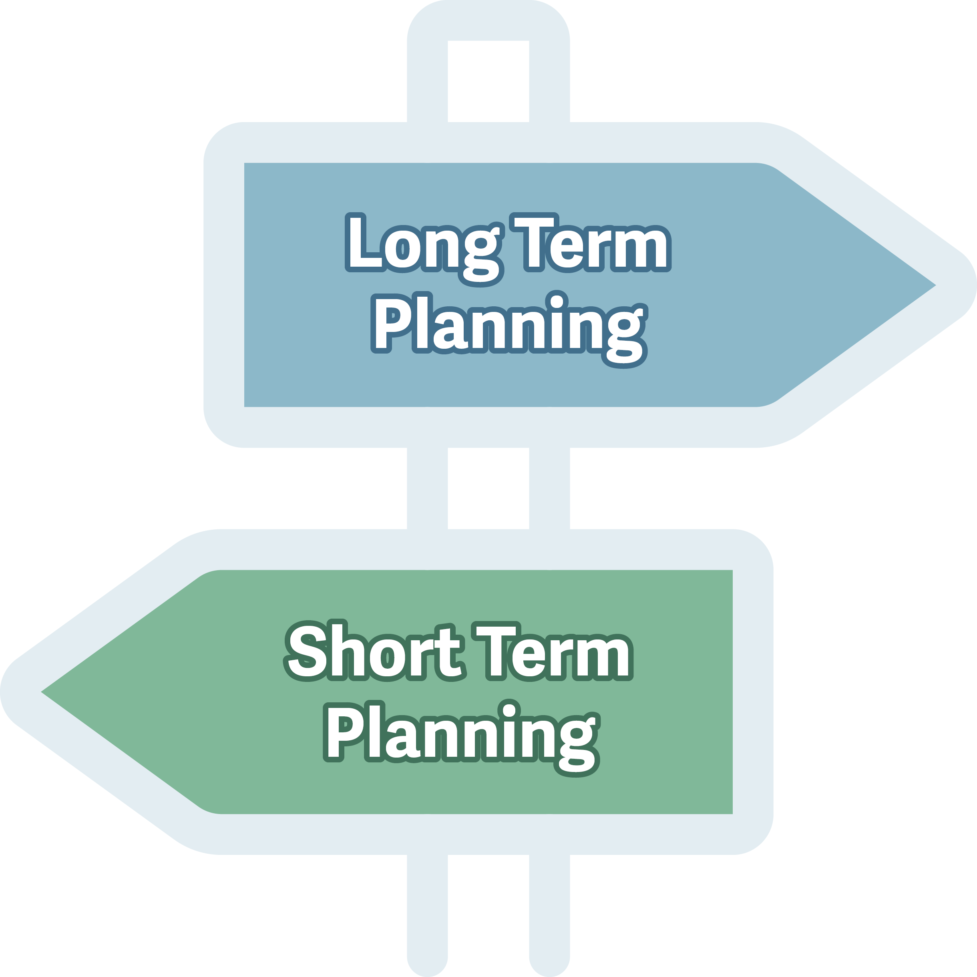
Process Outcomes
Scenarios
Present scenarios
Obtain feedback
Desired Action Items
Obtain feedback

Slide 5
Desired Action Items
Planning horizon to begin implementation within next 0-5 years
Feedback received to date helped developed this list
Themes, issues and/or concerns from stakeholders
Notes:
KW
Clarify this isn’t signing up the city to do these in the next 5 years – it’s potential
Overview – not deep dive

Slide 6
Scenarios

Slide 7
Scenario Development
Draft scenarios
Existing Airport with Enhanced Maintenance
Airport with Aviation Improvements
Airport with Neighborhood Serving Uses and Housing Lite
Decommission Airport and Create New Neighborhood
Exercise
What elements do you like?
What elements don’t you like?
Notes:
KW Picking the best elements from each scenario to create the ideal scenario
Explain – bring forward elements shown in 1-4 as you consider a 3A option
There are stickies in front of you to answer these questions along the way

Slide 8
Scenario Development
Scenarios are conceptual in nature
Scenarios are a high-level view for what might be possible at the airport
Scenarios represent a range of options
Scenarios have a range of cost, feasibility and affordability
Scenarios are first draft, together we want to modify and build
Notes:
Please hold questions until the end
BY – here to present, don’t feel compelled to answer questions Questions start with KW and passes

Slide 9
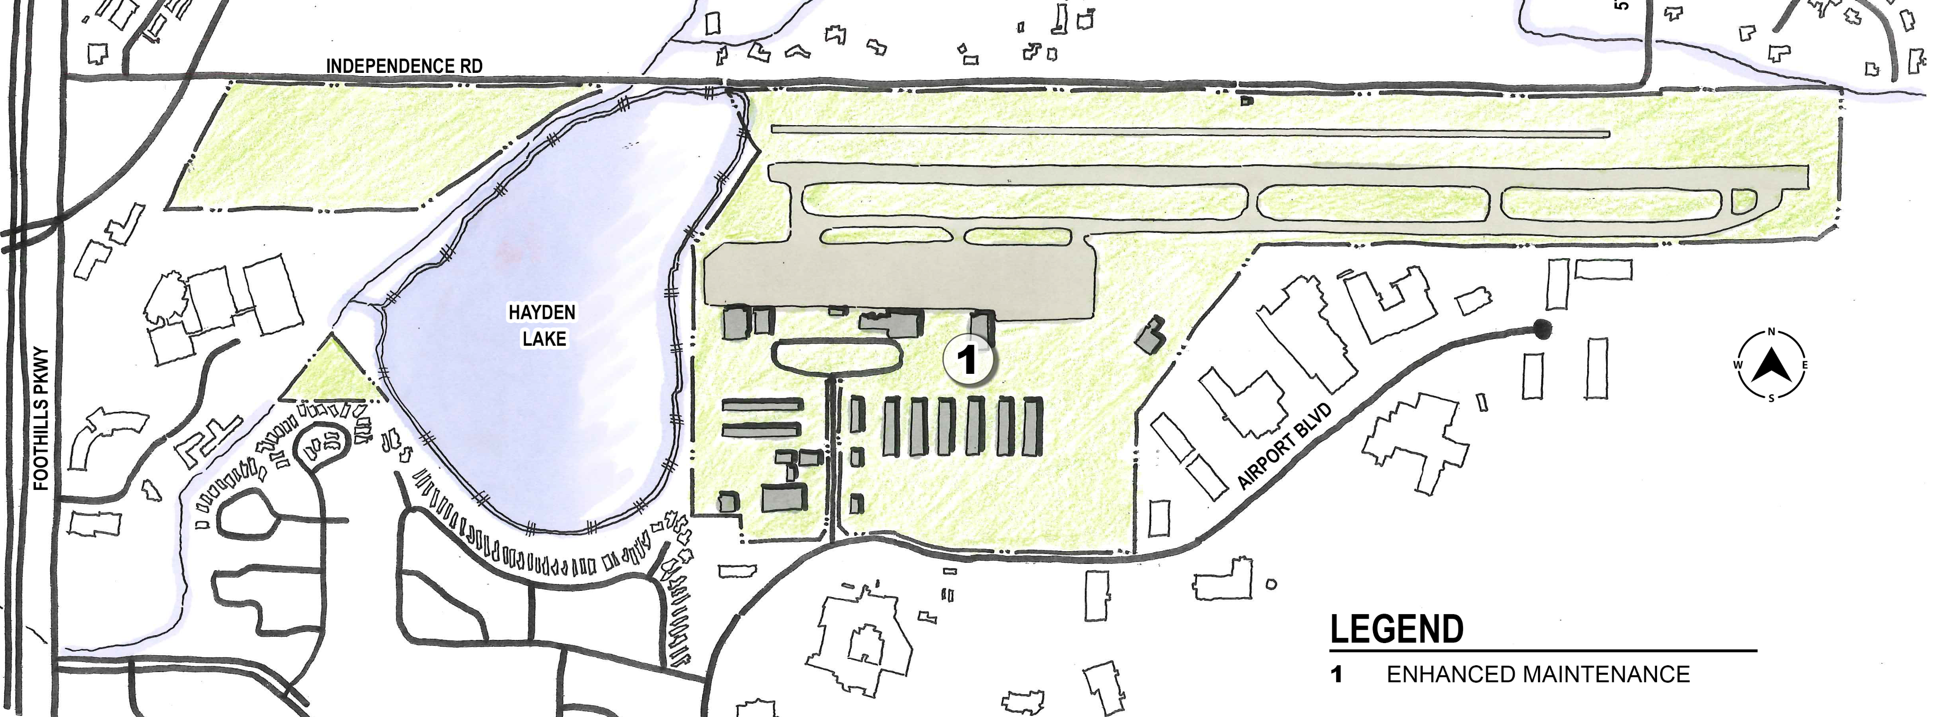
Scenario 1 Existing Airport with Enhanced Maintenance
Notes:
No change – make it clear

Slide 10
Scenario 1 Existing Airport with Enhanced Maintenance
Description
This scenario would bring the current facilities up to a state of good repair. No new facilities would be built.
Elements that Remain
Existing runways and taxiways
Existing hangar facilities
Existing support buildings
Elements that Change
No physical changes outside of enhanced maintenance of existing facilities

Slide 11
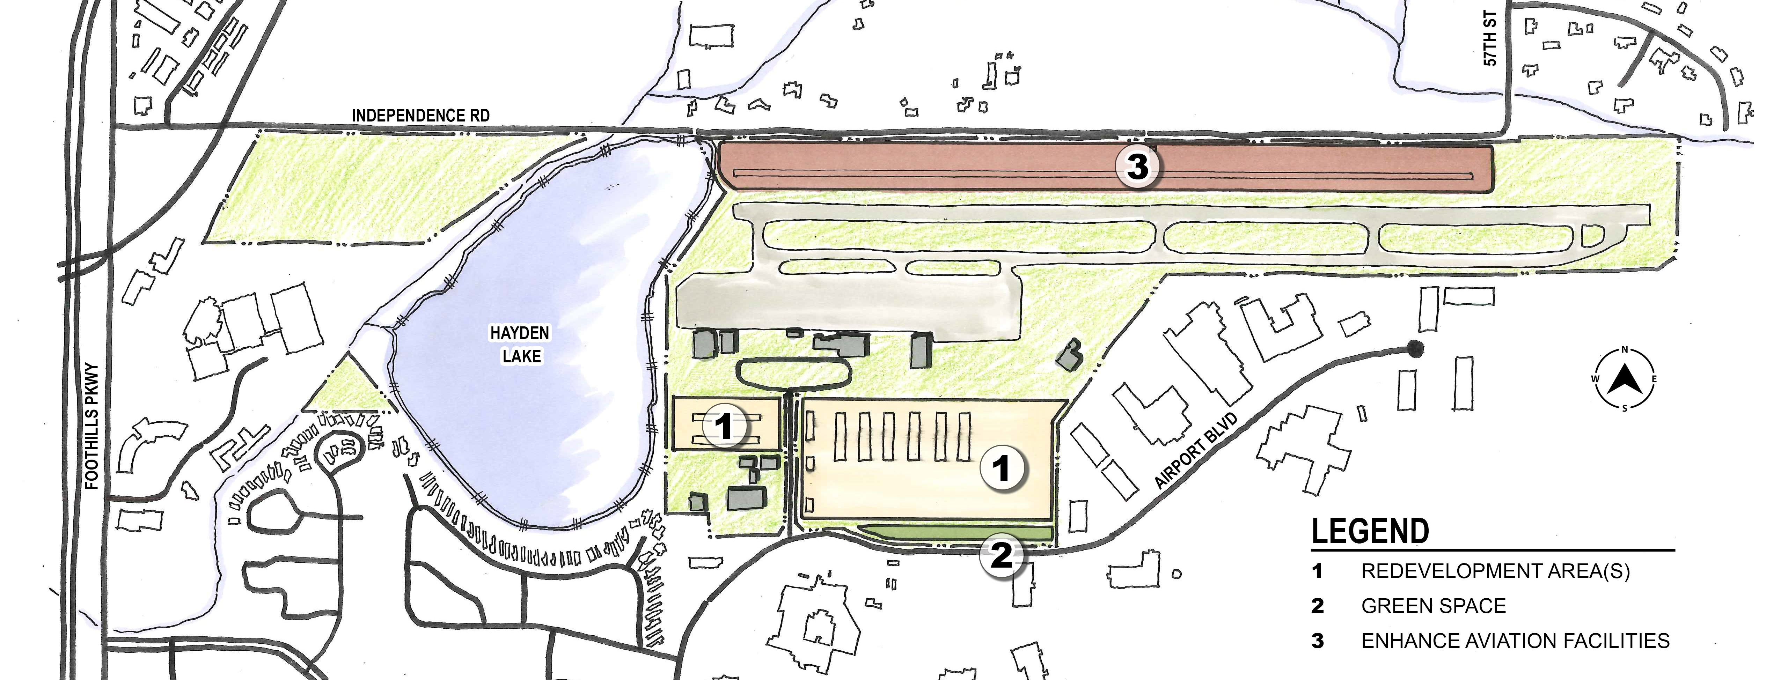
Scenario 2 Airport with Aviation Improvements

Slide 12
Scenario 2 Airport with Aviation Improvements
Description
This scenario would foster aviation development that is responsive to market and community demand. Includes modernization of general aviation, hangar improvements, and implementing the most recent Airport Master Plan, which may increase flight capacity.
Elements that Remain
Existing runways and taxiways
Existing hangar facilities
Existing support buildings
Elements that Change
Upgrade existing hangars
Development of additional hangars
Enhance aviation facilities
Preserve options to accommodate future modes of travel and good movement
Upgrade public aviation viewing area
Notes:
Spend more time on the written – notice the wording changes made – its about the elements, not the locations on the map

Slide 13
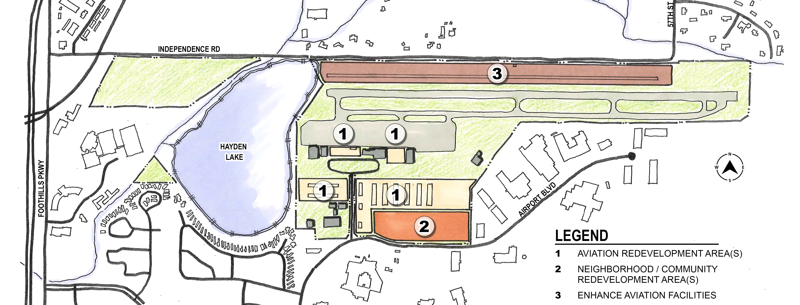
Scenario 3 Airport with Neighborhood Serving Uses and Limited Housing
Notes:
Examples may include:
Live/work (housing on top of hangar)
Housing along Airport Blvd. - some acreage dedicated to housing
Agreed with Jeffrey's comment that this needs more clarity. I believe the intention is for both live/work and non live/work housing to be considered in this scenario.

Slide 14
Scenario 3 Airport with Neighborhood Serving Uses and Housing Lite
Description
This scenario would foster aviation development and community development that compliment each other. Includes modernization of general aviation and hangar improvements and live/work hangars. Includes a wide range of neighborhood serving uses such as a restaurant or cafe, science, technology, engineering, and mathematics (STEM) learning center and vocational opportunities for local youth, and a community center that houses meeting spaces.
Elements that Remain
Existing runways and taxiways
Existing hangar facilities
Existing support buildings
Elements that Change
Upgrade existing hangars
Develop live/work hangars
Build a restaurant or cafe
Create a STEM learning center and vocational opportunities for local youth
Enhance aviation facilities
Build a community center that houses meeting spaces
Notes:
In no particular order

Slide 15
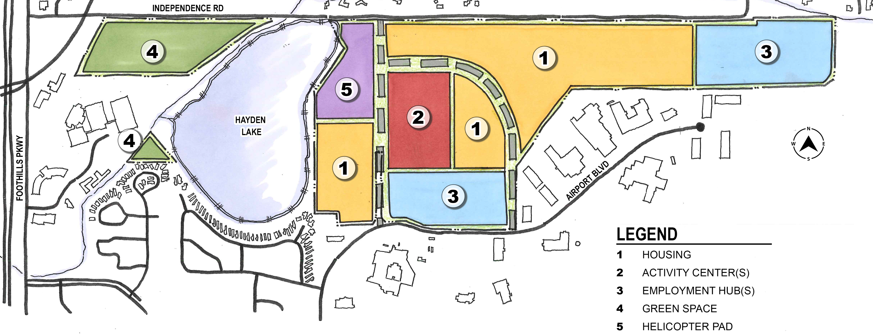
Scenario 4 Decommission Airport and Create New Neighborhood

Slide 16
Scenario 4 Decommission Airport and Create New Neighborhood
Description
This scenario would decommission the airport and create a new, mixed-use neighborhood that may include housing, activity centers, employment hubs, and green space. A portion of land would be set aside for helicopter emergency services that would support resiliency of the region.
Elements that Remain
Aircraft landing area for emergency support services
Elements that Change
Build a range of housing types
Create activity centers
Create employment hubs
Allocate green space for the needs of native plants and animals

Slide 17
Exercise

Slide 18
Scenario Feedback Go to Each Station
What questions do you have on each scenario?
What elements do you like?
What elements don’t you like?

Slide 19
Next Steps

Slide 20
Next Steps
Bilingual Community Meetings – August 22 and 29, 2023
City Council Presentation – August 24, 2023
CWG Meeting #5 – September 2023
City Council Presentation – January 2024

Slide 21
Thank You

