Slide 1
Marijuana keyholder and OWNER VIRTUAL MEETING
Presented by:
City of Boulder CANNABIS Team
December 14, 2021
This presentation will be posted to City Calendar & Marijuana webpages

Slide 2
Staff Introductions
Rebecca Bostrack and Rich Denig, Boulder Police Dept
Mike Rangel, Boulder Fire Department
Kevin Bennett, Planning & Development Services
Joel Wagner, Finance and Revenue
Mishawn Cook, Licensing Manager
Kristen Teague, Jon Yslas, Katelyn Kellogg and Raymond Jefferson- Licensing Operations Specialists
Kathy Haddock, Senior Counsel

Slide 3
Purpose of Meeting
City staff will provide recent updates and information, especially focusing on current city changes due to COVID from 2020 to present:
Online Licensing and Sales Tax Applications
City Cannabis Emergency Rules (now expired)
City Team Inspection Protocols during this time
Cannabis Licensing and Advisory Board (CLAB)
Hemp Business Licensing requirements
Make sure you sign in and that your email address is on Licensing’s email distribution list

Slide 4
Check out the new city website and update your links!
Go to: https://bouldercolorado.gov/government/departments/regulatory-licensing
In the last paragraph at the bottom of that page is a link to “Services & Programs” which if selected will take you to all licenses that our division handles
All the Same License Types and Webpages are there, but be sure to check out the “How To Apply” sections with instructions on how to file applications and pay on line, and also with information about our WEDNESDAY MORNING APPLICATION CLINICS on each webpage!

Slide 5
Wednesday morning clinics and mj email routing list!
Wednesday morning application clinics continue by phone from 10:30AM to 11:30AM- call in number and meeting code on the Recreational, Medical, and Hemp webpages
Also email licensingonline@bouldercolorado.gov to be added to email group to always receive updates
Consider adding your general managers and compliance directors to this list

Slide 6
Online APPLICATIONS and city emergency rules
CITY LICENSING STAFF

Slide 7
CITY EMERGENCY RULES FOR MARIJUANA BUSINESSES
Curbside provision for online and phone marijuana sales HAS EXPIRED
Waiver of late fee for late filed city renewals HAS EXPIRED
City of Boulder, including City Licensing, has had remote working extended due to technology needs and office space concerns until further notice. We do look forward to returning to Brenton Building for hybrid work but do not have a date at this time
Cannabis City Team will resume in person inspections starting October 2021

Slide 8
KEYHOLDER APPLICATION – changes final
City Keyholder applications will now be a one-page application that owners will complete and email to our main email address at: LicensingOnline@bouldercolorado.gov
City Keyholder applications will no longer be available to submit on EnerGov CSS system
City Keyholder $150 fees will be waived, except for city created lists
City Keyholder lists will be fully reviewed by City Licensing only at license renewal time

Slide 10
Online Renewal Applications
Your business will be emailed renewal documents which include online filing and payment instructions-Please make sure we have your correct email addresses
Waiver of non-collection of late filing fee ended on 9/7/2021!!!
In-person inspections resumed in October but please be patient to allow for backlog
No later than 1 week after city renewal is received, must schedule city inspections
with all 3 departments via email.
UPDATED-NEW FORM- Request for Renewal Inspections of Marijuana Businesses
UPDATED-Inspection checklists available on city website
Certificate of Insurance required for every renewal, esp. General Liability and Workers Compensation
Renewal Summary Report form included in renewal applications and required for each license
City Keyholders List checked at renewal (those not listed will be marked as removed) required
Odor Control Plan for Grows for all city renewals
Note deadline and new city renewal fee (tiers and types- note state change) on renewal cover letter

Slide 11
Secure folders and upcoming web page changes
City Licensing has created a new secure folder system
Short website form completed, and then secure folder created with link sent to applicant
Once CSS account created and invoices generated which can be paid online
CITY LICENSING WEB PAGE HAS CHANGED= GO TO https://bouldercolorado.gov/services and in left Explore by Category drop down menu, pick “Regulatory Licensing”

Slide 12
CITY OF BOULDER
SALES TAX

Slide 13
The new Boulder Online Tax System is live!
Here’s what you need to know:
Access the new site here: https://boulderonlinetax.gentaxcpc.net/TAP/
Boulder Online Tax help videos and articles are here: https://bouldercolorado.gov/finance/boulder-online-tax-system-help-center
Contact Sales Tax Staff at salestax@bouldercolorado.gov

Slide 14
IMPORTANT changes WITH online filing:
City of Boulder will no longer be mailing returns
Recreational Dispensaries and Grows will have two returns to file:
Standard Sales and Use Tax (3.86%)
Additional Sales and Use Tax (3.50%)
Accounts sharing the same Federal Tax ID Number (FEIN) will file a consolidated return under one web logon

Slide 15
All Marijuana Businesses Use Tax Types/Rates City Total
Use Tax on all Marijuana Businesses 3.86%
Applies to Fixed Assets, Taxable Expenses, and Withdrawals from inventory
Additional Use Tax on Recreational 3.5% 7.36%
No free employee samples or free MJ products are allowed
Applies to withdrawals at minimum cost of marijuana and marijuana infused products from inventory
Notes:
Sales tax is paid on the retail sales amount charged to the customer.
Use tax is paid on the cost of assets and expenses of the business

Slide 16
Marijuana Retail Businesses Sales Tax Types/Rates City
Sales Tax on all Marijuana and Merchandise CITY
Medical Marijuana Sales Tax 3.86%
Applies to all sales including marijuana, marijuana infused products, paraphernalia, and all merchandise
Additional Sales Tax on Recreational 3.5%
Applies to all recreational marijuana and marijuana infused products
City Tax Chart and linked State AMR which is followed by city sales tax as linked to available on Sales and Use tax city website
Notes:
Sales tax is paid on the retail sales amount charged to the customer.
Use tax is paid on the cost of assets and expenses of the business

Slide 17
Medical Grows and Recreational Grows/MIP use and excise Rates
CITY
All Medical Marijuana Grow Use Tax 3.86%
Applies to Fixed Assets, Taxable Expenses, and Withdrawals from inventory
For the city, there is no excise tax for medical marijuana grows
Recreational Grows and MIPs Use Tax 7.36%
Applies to Fixed Assets, Expenses, and withdrawals of merchandize from inventory
Recreational Grows City Excise Tax 5.00%
Due when any Recreational marijuana leaves the grow facility
State AMR effective quarterly as updated are applied to City Taxes chart available on Sales and Use tax city website

Slide 18
You can always reach us AT: City licensing can be reached at: licensingonline@bouldercolorado.gov SALES TAX can be reached at: salestax@bouldercolorado.gov

Slide 19
CANNABIS INSPECTION TEAM
SCHEDULING AND INSPECTION HIGHLIGHTS

Slide 20
Scheduling Your Renewal Inspections All inspection requests must be made within 7 days from the date you receive your emailed renewal from City Licensing Staff
Email your Inspection Request to all the Inspection Team Members with the full details of your cannabis business(es) including the name of the contact person for your business
You must attach the Fire Department Contact Information Sheet with your Inspection Request Email
Renewal Packets are emailed to you with the following form:
UPDATED- Request for Renewal Inspections of Marijuana Businesses
You must complete this form for your renewal and add the date you emailed the Inspection Team for your request for inspection. The date must be no later than 7 days from the date you were emailed your renewal from City Licensing Staff.
Failure to timely schedule your inspections could result in a delay in getting on the inspector’s calendars with sufficient time to meet your renewal expiration

Slide 21
Boulder police department
OFFICER REBECCA BOSTRACK
303-710-3494
bostrackr@bouldercolorado.gov
*Temporary contact starting January 7, 2022 will be the Liquor Enforcement Officer Rich Denig at
720-440-4372
denigr@bouldercolorado.gov

Slide 22
BOULDER FIRE DEPARTMENT Mike Rangel, Assistant Fire Marshal rangelm@bouldercolorado.gov

Slide 23
2018 International fire codes
BOULDER FIRE DEPARTMENT HAS UPDATED THEIR INSPECTION CHECKLISTS TO REFLECT UPDATES TO THE NEW INTERNATIONAL CODE CHANGES.
These will be posted on both our Medical and Recreational Marijuana Business Licenses web pages under "Cannabis Business Inspection Checklists" along with all other departmental inspection checklists.

Slide 24
Fire DEPARTMENT
MSDS Information/Signage and Inspection Requirements
Three products from the MSDS book will pulled by Inspector and shall be found by an employee for review.
Hazard identification signs shall be placed on stationary containers and above- ground tanks and at entrances to locations where hazardous materials are stored, dispensed, used or handled in quantities requiring a permit and at specific entrances and locations designated by the fire code official

Slide 25
FIRE DEPARTMENT
Label all containers that contain liquid, even huge watering bins
Write the letters in large, bold print such as “H2O” or “Nutrients” so firefighters can read them from a distance in case of a spill. This will help avoid your facility being shut down as a haz-mat situation.
Permanent marker is usually better than paper

Slide 26
LA Prosecutor Files Over 300 Criminal Charges for Alleged Fire Code Violations Following DTLA Boyd Fire That Injured 12
LA Prosecutor Files Over 300 Criminal Charges for Alleged Fire Code Violations Following DTLA Boyd Fire That Injured 12
Most egregious charges include:
Failure to maintain aisles, improper shelf storage, illegal height storage
Failure to have hazmat warning signs, to classify hazardous commodities, & to have no smoking signs
Failure to obtain a facility permit, hazmat storage without permits, to identify aerosols
Failure to have key boxes, proper sprinkler coverage, and to maintain a safe building
https://knx1070.radio.com/articles/la-prosecutor-files-300-criminal-charges-over-massive-fire

Slide 27
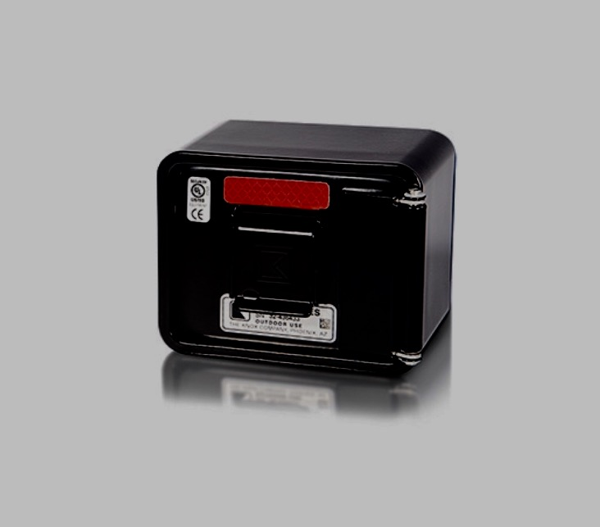
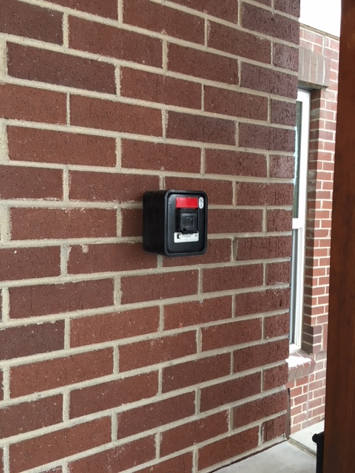
Fire Department
KNOX BOX SECURITY SYSTEM – Only the Fire Department has access to the Knox Box

Slide 28
BUILDING DEPARTMENT
KEVIN BENNETT
PLANNING & DEVELOPMENT
SERVICES
bennettk@bouldercolorado.gov

Slide 29
Building DEPARTMENT
Code requirement states that the business must be ventilated so that the odor of cannabis cannot be detected at the exterior of the cannabis business or at any adjoining use or property.” Boulder Revised Code for marijuana 6-14-8(h) & 6-16-8(h). Boulder Revised Code for hemp 4-33-7 (d).
No extension cords (or power strips) as permanent wiring
AFFIX WELL refrigerators and freezers to structures

Slide 30
Common Plumbing Violations

Slide 31
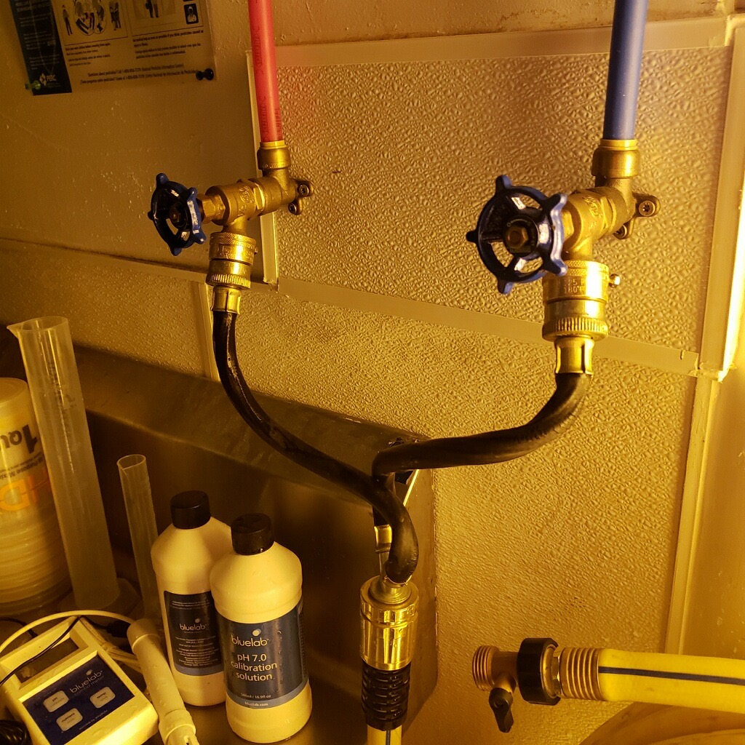
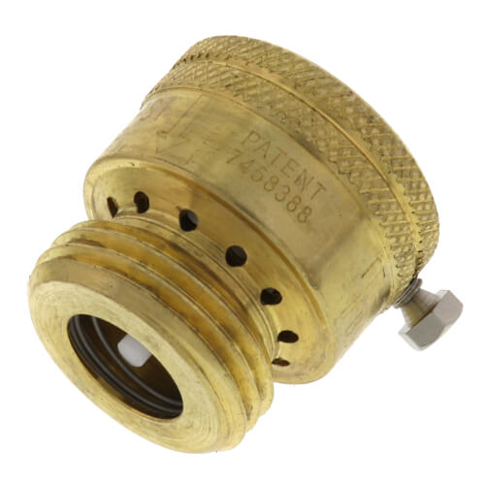
Solutions

Slide 32
Common Electrical violations

Slide 33
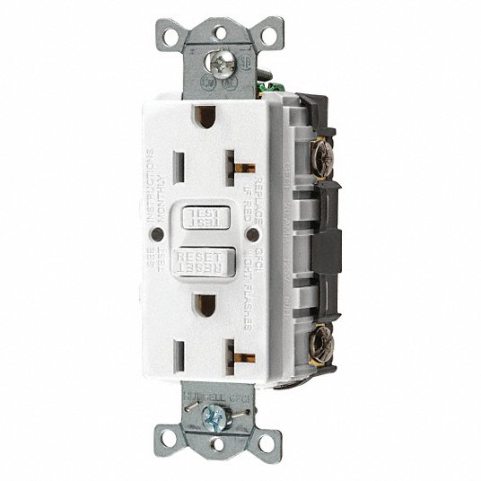
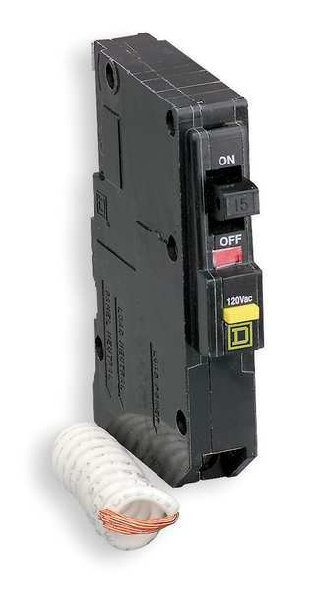
solutions

Slide 34
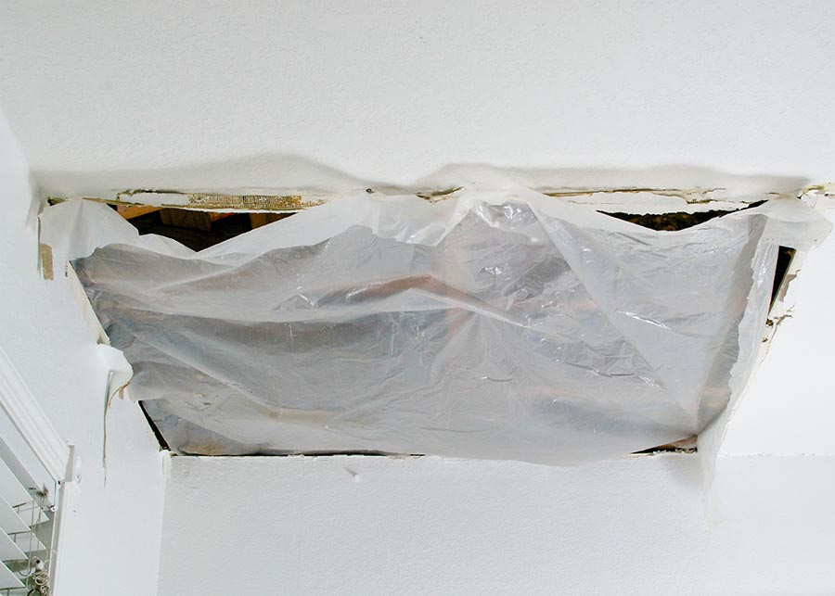
Common building violations

Slide 35
CANNABIS LICENSING & Advisory BOARD (clab) and new hemp registration and licensing
MISHAWN COOK
LICENSING MANAGER

Slide 36
CANNABIS Licensing & advisory board (CLAB)
CLAB will meet the first Monday of each month with meetings starting at 3PM
CLAB will start by discussing Policy, and then transition into Policy and Licensing (not enforcement). CLAB 2021 to 2022 recommendations to Council January 2022 soonest. CLAB did approve CBD from hemp consumables as of 7/1/2021 for Boulder dispensaries.
CLAB is a 7-member volunteer board (+ 2 ex-officio members) with representatives from MJ industry, health and education, and community at large
Policy Suggestion Forms may be submitted (found on CLAB webpage), and 3-minute public comment taken
CLAB meeting agendas are sent to MJ email routing group
CLAB Meetings now being held virtually and recordings/materials are posted to CLAB website https://bouldercolorado.gov/government/board-commissions/cannabis-licensing-advisory-board

Slide 37
Hemp 2020 registration and 2021 licensing
Hemp business licensing city law became effective on August 7, 2020
Just required for hemp extraction and cultivation, not for sales only businesses
For existing businesses that already have/have applied for city business license by 6/16/20,
Resulted in 4 Hemp Extraction licenses, 3 Withdrawn applications, and 2 locations that were exempted based on the commissary kitchen exemption

Slide 38
THANK YOU FOR COMING!!
ANY QUESTIONS?

